Slide 1


Introduction to Neural Network - Week 1
AIML
POST GRADUATE PROGRAM
ARTIFICIAL INTELLIGENCE & MACHINE LEARNING

Slide 2
Learning Objectives
Deep learning VS Machine learning
Introduction to Neural Network
Introduction to TensorFlow
Introduction to Keras
Basics of Colab
Basics of MNIST Dataset
Case Study
Questions

Slide 3
What distinguishes deep learning from machine learning?
Machine Learning(ML) | Deep Learning (DL)
It can easily train on lesser data and requires lesser time to train | It requires large data(Not necessarily) and longer time to train
It trains on CPU | It trains on GPU
Some ML algorithms can be easily interpreted | Difficult to interpret.

Slide 4
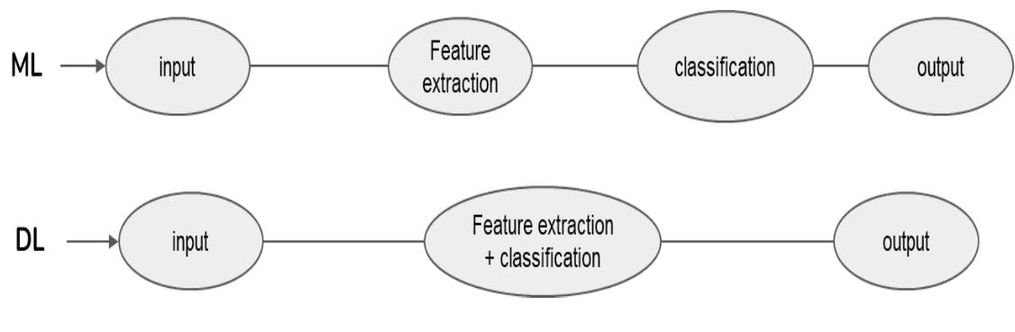
What distinguishes deep learning from machine learning? (Cont)

Slide 5
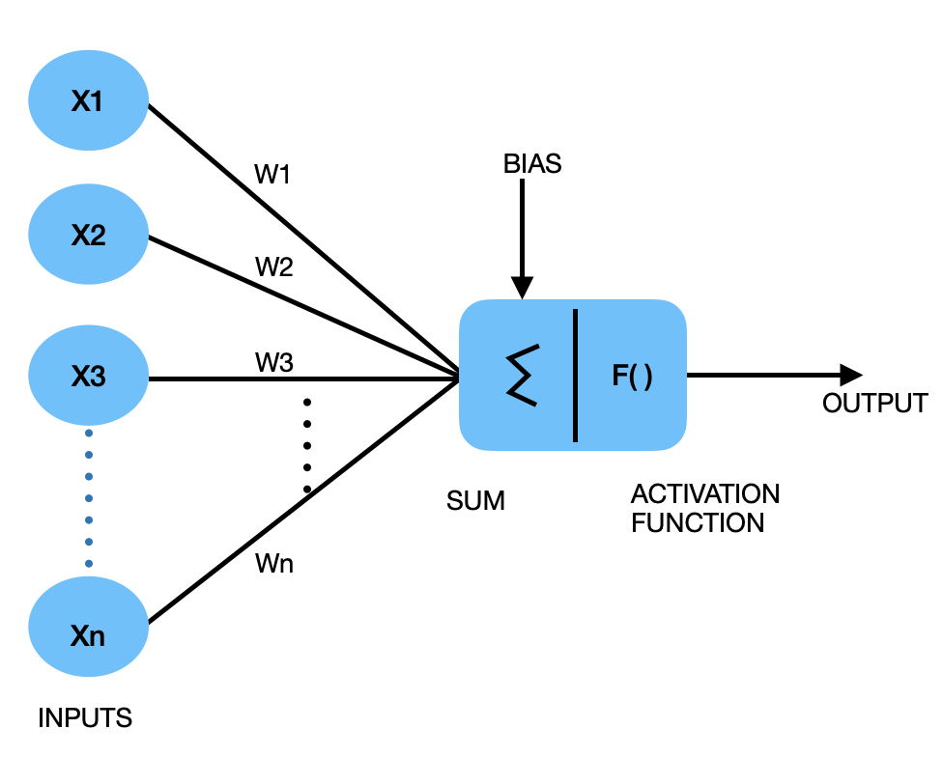
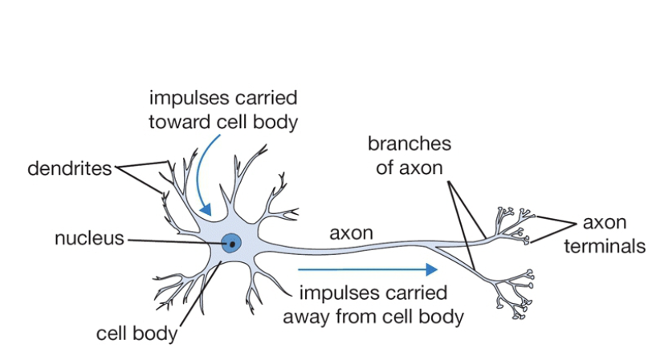
Neuron
Biological
Neuron
Artificial
Neuron

Slide 6
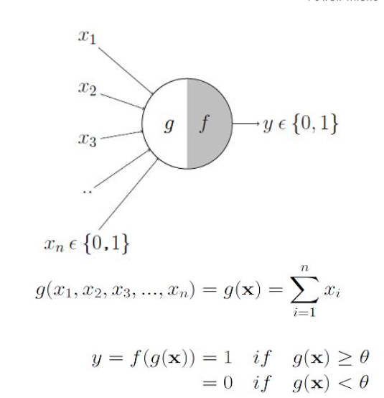
Warren McCulloch & Walter Pitts Neuron
It has an input layer that acts like dendrites
It has two parts the first part, g the weighted addition of inputs. The weights are manually initialized, and all have the same weight
The weighted sum is passed through the second part an activation function f which yields a 1 if the threshold is crossed else 0.
Image Reference

Slide 7
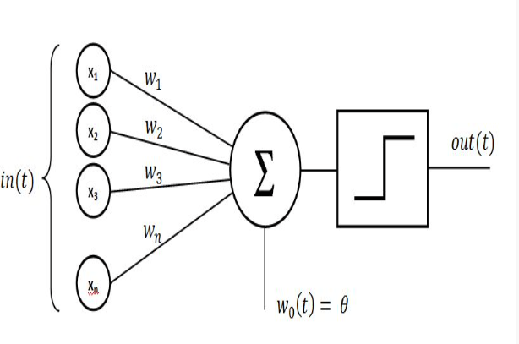
Rosenblatt’s Perceptron
It has an Input layer that acts as dendrites
2. It has two parts, the first part is weighted
addition Each input is multiplied with a weight (which is typically initialized with some random value)
3. The sum is then passed through an activation function which yields a 1 if the threshold is crossed
4. The step function can be defined in such a way that output can range from -1 to +1
5. It captured the error and had a logic built in to adjust the weights automatically to reduce the error.
Image source

Slide 8
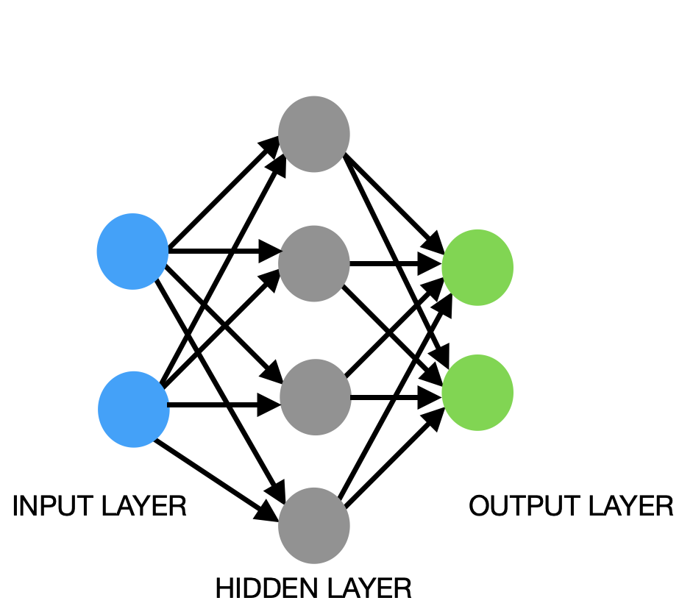
Neural Network and It’s Layer Details
Input layer
Represents dimensions of the input vector (one node for each dimension)
Hidden layer(s)
Represents the intermediary nodes that divide the input space into regions with (soft) boundaries
Given enough hidden nodes, we can model an arbitrary input-output relation
It takes in a set of weighted input and produces output through an activation function
A 2-layer neural network
Output layer
Represents the output of the neural network
Most commonly it doesn't have any activation function

Slide 9
Train a Neural Network
Choose hyper parameters
Choose network design
Choose
Form a neural network
Form
Compute an estimate value for all samples
Compute loss
Compute
Reduce loss
Reduce
Repeat last three steps
Repeat
Image source: towardsai.net

Slide 10
Training On Specialized Hardware
Training of deep learning models on GPU is faster than CPU
Image and text source : Google cloud blogs

Slide 11
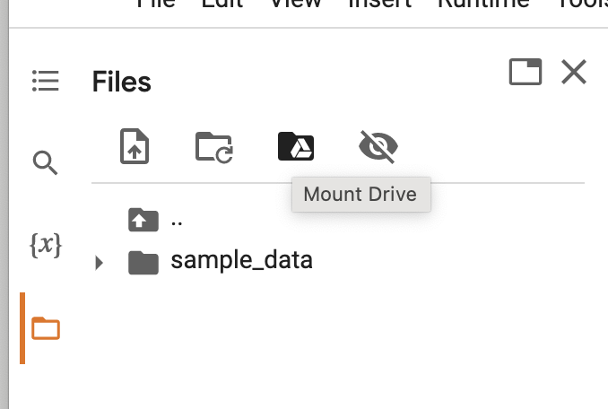
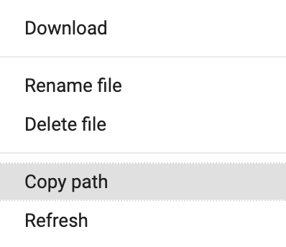
Basics of Google Colab
Colab is a online Jupyter Notebook Environment
Tensorflow latest version can be readily utilised
Dataset in our google drive can easily be linked in our notebooks
Link / Path to the dataset can be provided by selecting the path of the file
Code is as follows ( Path is as per the folder we put our datasets here it is under My drive)

Slide 12
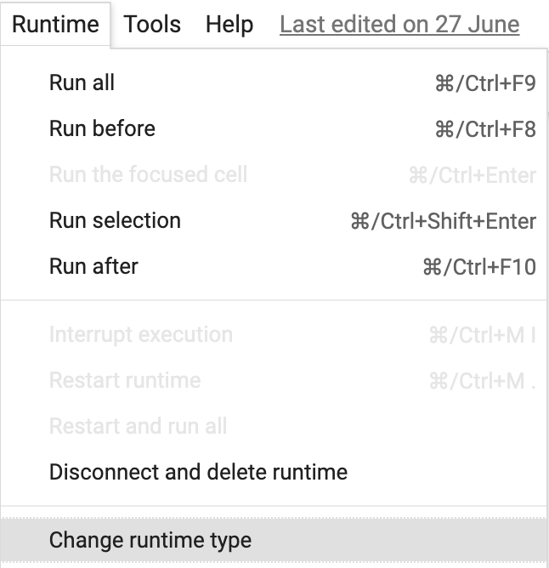
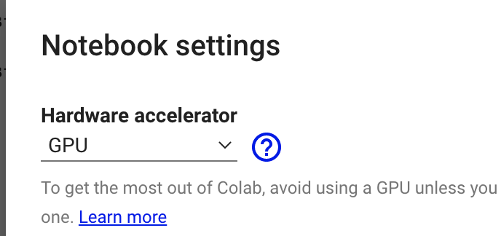
Selection of GPU
Click On Change Runtime Type
Select GPU

Slide 13
Limitations of Google Colab
GPU and RAM provided in colab free tier is limited and hence it has to utilised efficiently

Slide 14

An open source machine learning library for research and production

Slide 15

What is TensorFlow
TensorFlow is an open-source machine learning library for research and production. TensorFlow offers APIs for beginners and experts to develop for desktop, mobile, web, and cloud.

Slide 16
Tensor Values
The central unit of data in TensorFlow is the tensor. A tensor consists of a set of primitive values shaped into an array of any number of dimensions.
A tensor's rank is its number of dimensions, while its shape is a tuple of integers specifying the array's length along each dimension. Here are some examples of tensor values:
TensorFlow uses numpy arrays to represent tensor values.

Slide 17
Graph
A computational graph is a series of TensorFlow operations arranged into a graph. The graph is composed of two types of objects.
tf.Operation (or "ops"): The nodes of the graph. Operations describe calculations that consume and produce tensors.
tf.Tensor: The edges in the graph. These represent the values that will flow through the graph. Most TensorFlow functions return tf.Tensors.
Let's build a simple computational graph. The most basic operation is a constant. The Python function that builds the operation takes a tensor value as input. The resulting operation takes no inputs. When run, it outputs the value that was passed to the constructor. We can create two floating point constants a and b as follows:
a = tf.constant(3.0, dtype=tf.float32)
b = tf.constant(4.0) # also tf.float32 implicitly
total = a + b
print(a)
print(b)
print(total)
The print statements produce:
Tensor("Const:0", shape=(), dtype=float32)
Tensor("Const_1:0", shape=(), dtype=float32)
Tensor("add:0", shape=(), dtype=float32)

Slide 18
Session
To evaluate tensors, instantiate a tf.Session object, informally known as a session. A session encapsulates the state of the TensorFlow runtime, and runs TensorFlow operations. If a tf.Graph is like a .py file, a tf.Session is like the python executable.The following code creates a tf.Session object and then invokes its run method to evaluate the total tensor we created above:
sess = tf.Session()
print(sess.run(total))
When you request the output of a node with Session.run TensorFlow backtracks through the graph and runs all the nodes that provide input to the requested output node. So this prints the expected value of 7.0:
7.0
You can pass multiple tensors to tf.Session.run. The run method transparently handles any combination of tuples or dictionaries, as in the following example:
print(sess.run({'ab':(a, b), 'total':total})) which returns the results in a structure of the same layout:
{'total': 7.0, 'ab': (3.0, 4.0)}
During a call to tf.Session.run any tf.Tensor only has a single value.

Slide 19
Eager Execution
TensorFlow's eager execution is an imperative programming environment that evaluates operations immediately, without building graphs: operations return concrete values instead of constructing a computational graph to run later. This makes it easy to get started with TensorFlow and debug models, and it reduces boilerplate as well. To follow along with this guide, run the code samples below in an interactive python interpreter.
Eager execution is a flexible machine learning platform for research and experimentation, providing:
An intuitive interface—Structure your code naturally and use Python data structures. Quickly iterate on small models and small data.
Easier debugging—Call ops directly to inspect running models and test changes. Use standard Python debugging tools for immediate error reporting.
Natural control flow—Use Python control flow instead of graph control flow, simplifying the specification of dynamic models.
Eager execution supports most TensorFlow operations and GPU acceleration.

Slide 20
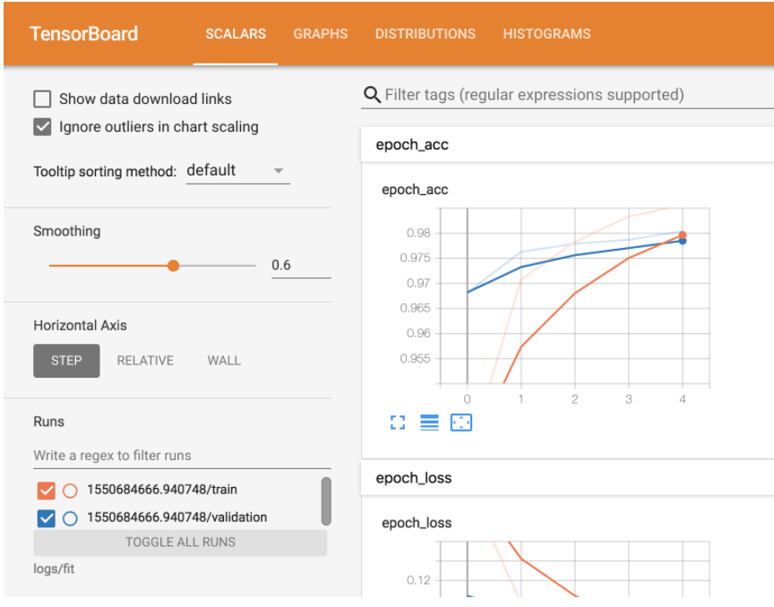
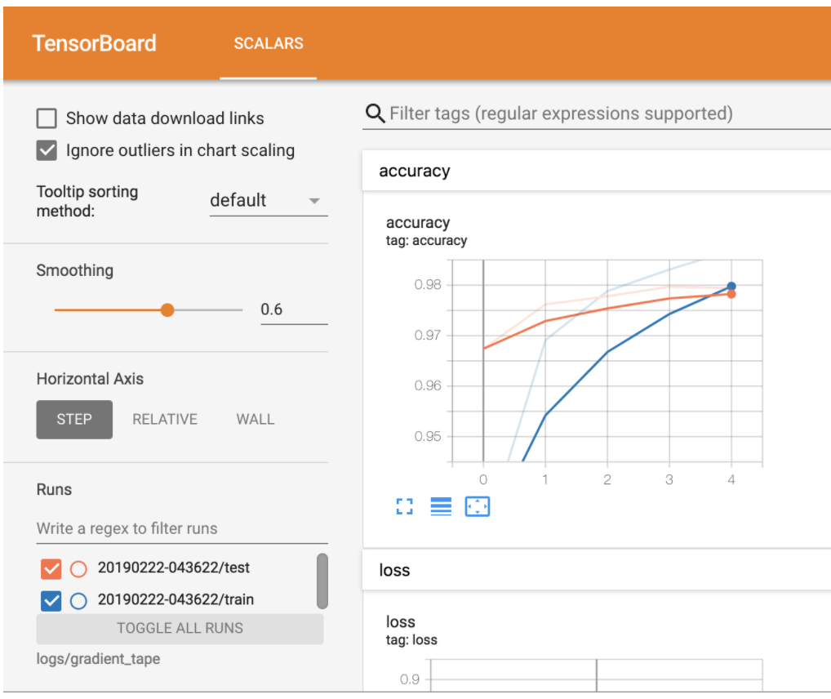
Tensor Board
TensorBoard is a tool for providing the measurements and visualizations needed during the machine learning workflow. It enables tracking experiment metrics like loss and accuracy, visualizing the model graph, projecting embeddings to a lower dimensional space
Once the model fit is completed,
%tensorboard --logdir logs/fit will provide us graphs on epochs

Slide 21


Slide 22
Keras is an abstraction layer which sits on the backend computational engines such as Tensorflow, Mxnet, Theano etc.
Most popularly used is Tensorflow as Computational backend
Keras Overview
Computational backend performs all the numerical calculations, constructing a graph etc.
tf.keras to be used in TF 2.x

Slide 23
Keras
Keras is a high-level API to build and train deep learning models. It's used for fast prototyping, advanced research, and production, with three key advantages:
User friendly Keras has a simple, consistent interface optimized for common use cases. It provides clear and actionable feedback for user errors.
Modular and composable Keras models are made by connecting configurable building blocks together, with few restrictions.
Easy to extend Write custom building blocks to express new ideas for research. Create new layers, loss functions, and develop state-of-the-art models.
Import tf.keras
tf.keras is TensorFlow's implementation of the Keras API specification. This is a high-level API to build and train models that includes first-class support for TensorFlow-specific functionality, such as eager execution, tf.data pipelines, and Estimators. tf.keras makes TensorFlow easier to use without sacrificing flexibility and performance.

Slide 24

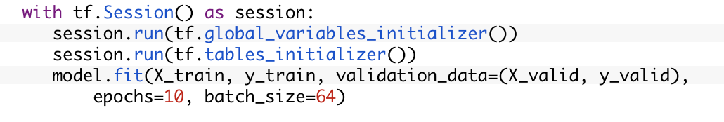
TensorFlow 2.x
Some of the Important changes in tensorflow 2.x are
Keras integration: Now keras is offered as part of tensorflow, hence tf.keras for all keras-tensorflow usage in DL projects, hence no need to use keras seperately
Sessions: In tensorflow 2.x, tf.Sessions is not used because Eager execution is built default
Tensorflow 1.x Tensorflow 2.x
Vs

Slide 25
Basics Of MNIST
MNIST is a dataset of Handwritten digits
It contains training set of 60000 examples and test set of 10000 examples
Dataset can be downloaded from this Link or from Kaggle
MNIST is a good starting point to learn concepts of Neural Networks

Slide 26
Thank You

